Slide 1
Technology for Success: Computer Concepts

Slide 2
Module 3
Computer Hardware

Slide 3
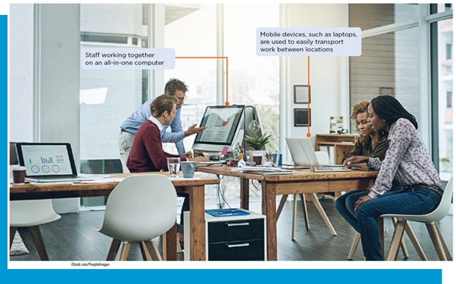
Lesson Objectives
Categorize the various types of computer hardware
Demonstrate familiarity with input and output devices
Maintain hardware components

Slide 4
Categorize the Various Types of Computer Hardware (1 of 2)
Define each component of computer hardware
Visually identify types of computer hardware
Explain how computers represent data
Explain the benefits of internal, external, and cloud-based storage solutions

Slide 5
Categorize the Various Types of Computer Hardware (2 of 2)
Explain the pros and cons of using different types of computer, including all-in-ones, tablets, mobile devices, and desktop computers
Determine which hardware features are personally necessary to consider when purchasing a computer

Slide 6
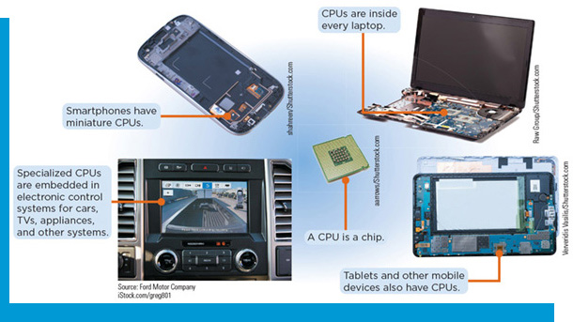
Define Each Component of Computer Hardware (1 of 3)
Central Processing Unit (C P U)
A complex integrated circuit consisting of millions of electronic parts and is primarily responsible for converting input (data) into meaningful output (information)
Data travels in and out of the C P U through a bus
Machine cycle

Slide 7
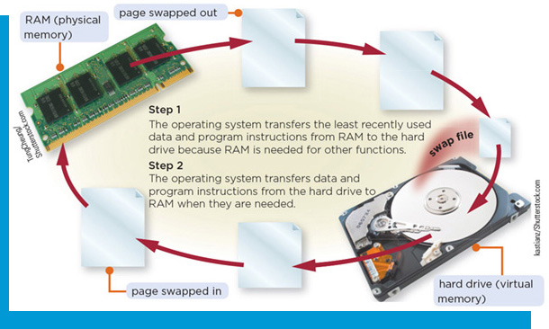
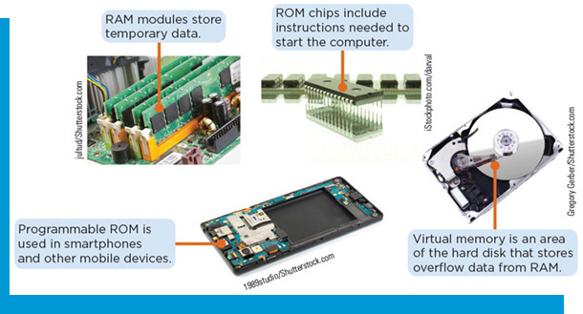
Define Each Component of Computer Hardware (2 of 3)
Computer Memory
Responsible for holding data and programs as they are being processed by the C P U
Random access memory (RAM)
Virtual memory
Swap file/paging file
Read-only memory (ROM)
B I O S
Power-on self test (POST)
Firmware

Slide 8
Define Each Component of Computer Hardware (3 of 3)
Input and Output Devices
Input device: communicates instructions and commands to a computer
Examples: keyboard, mouse
Output device: conveys information from the computer to the user
Examples: speakers, printers

Slide 9
Visually Identify Types of Computer Hardware (1 of 2)
Common Types of RAM
Table 3-1: Types of RAM
Type of RAM | Description | Volatile or nonvolatile
Dynamic RAM (D RAM) | Memory needs to be constantly recharged or contents will be erased | Volatile
Static RAM (S RAM) | Memory can be recharged less frequently than D RAM, but can be more expensive than D RAM | Volatile
Magnetoresistive RAM (M RAM) | Memory uses magnetic charges to store contents, and can retain its contents in the absence of power | Nonvolatile
Flash memory | Fast type of memory that typically is less expensive than some other types of RAM, and can retain its contents in the absence of power | Nonvolatile

Slide 10
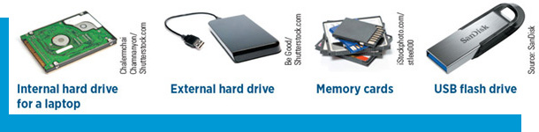
Visually Identify Types of Computer Hardware (2 of 2)
Storage Devices
Designed to store data for extended periods of time
The type and amount of data helps to determine the most appropriate storage device to use
Figure 3-5: Storage devices

Slide 11
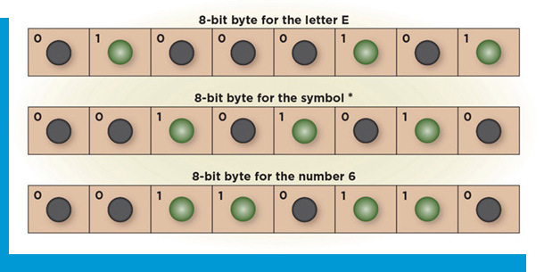
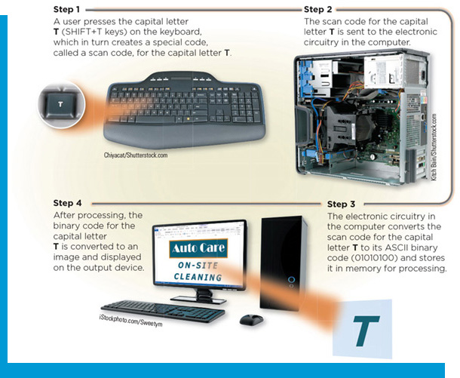
Explain How Computers Represent Data
Binary System
Bit
Byte
Text coding scheme
ASCII
Unicode

Slide 12
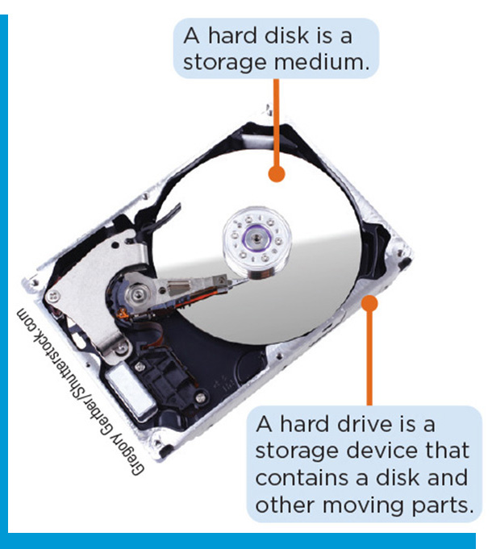
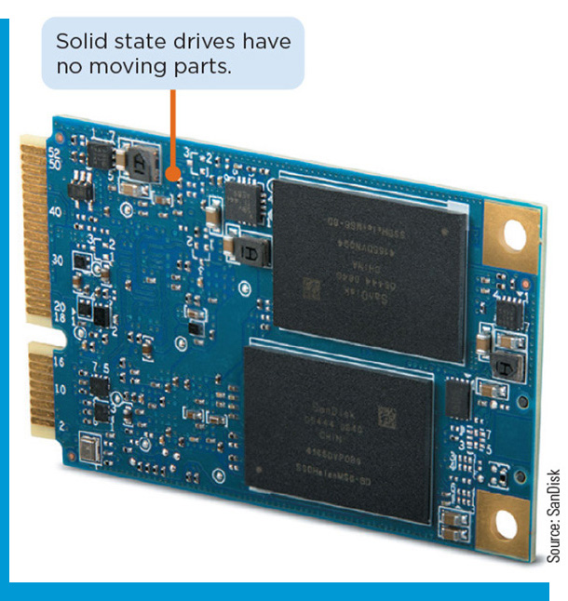
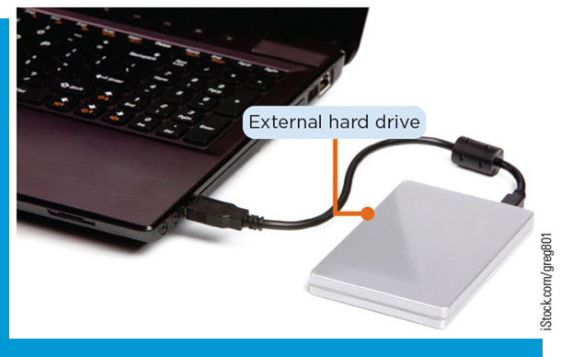
Storage Solutions (1 of 2)
Hard Drives
Internal hard drives
Magnetic hard disk drives (H D D s)
Solid State Drive (S D D)
External hard drives
U S B flash drive
Optical media

Slide 13
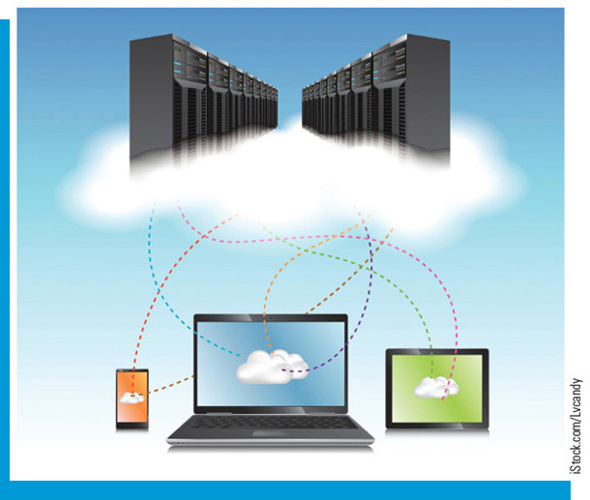
Storage Solutions (2 of 2)
Cloud Storage
Storing electronic files on the Internet instead of a local computer
Google Drive, Microsoft OneDrive, Dropbox

Slide 14
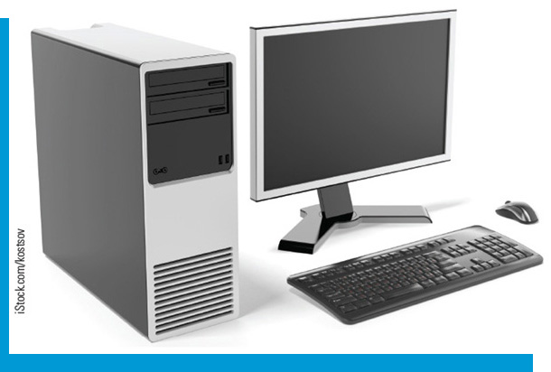
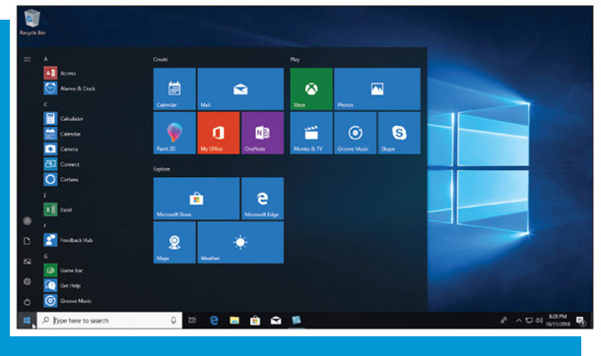
Pros and Cons of Different Types of Computers (1 of 3)
Desktop Computer
Typically consists of a system unit, monitor, keyboard, and mouse
More powerful, more storage
Hardware components can be easily upgraded

Slide 15

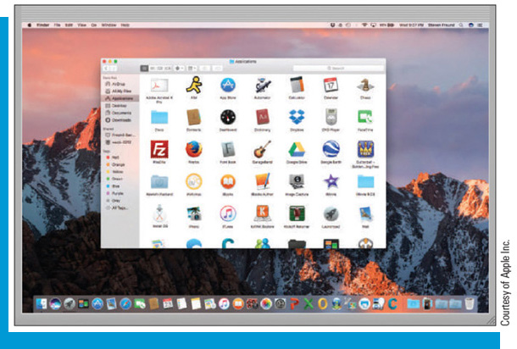
Pros and Cons of Different Types of Computers (2 of 3)
All-in-one Computer
Monitor and system unit are housed together
Take up less space and easier to transport
Typically more difficult to service or upgrade
More expensive than desktops

Slide 16
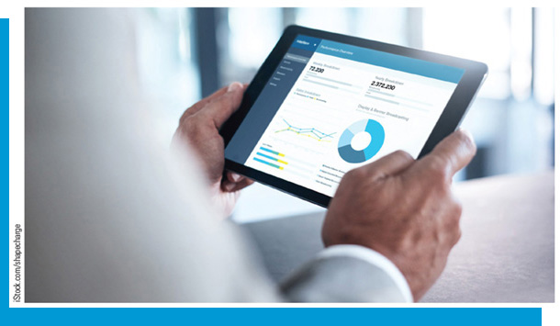
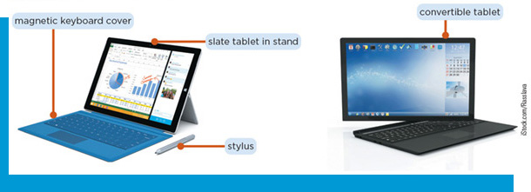
Pros and Cons of Different Types of Computers (3 of 3)
Mobile Device
Portable or handheld computing device
Tablet
Less powerful
Not upgradeable

Slide 17
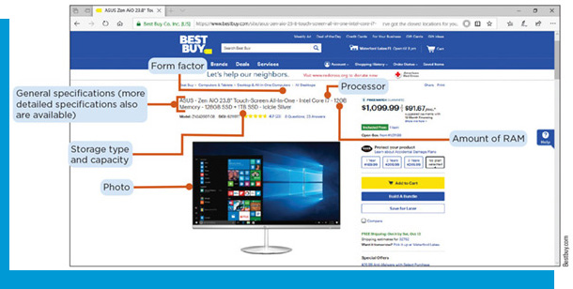
Hardware to Consider When Purchasing a Computer (1 of 3)
Table 3-2: Factors to consider in buying a computer
Consideration | Questions
Platform | Do I need to use software that requires a specific platform? Does the computer need to be compatible with other devices I own that use a particular platform?
Hardware | Do I require specific hardware to perform intended tasks? How much data and information do I plan to store on the computer?
Hardware specification | Will the tasks I perform or software I want to run require certain hardware specification?
Form factor | Will I be using this computer in one location, or will I need to be mobile?
Add-on-devices | What additional devices will I need to perform my intended tasks?

Slide 18
Hardware to Consider When Purchasing a Computer (2 of 3)
Table 3-3: Evaluating system requirements
Specification | Recommended solution
Different processor requirements | Identifying the program or app with the greater processor requirement and select a computer with a processor that meets or exceeds the requirements
Different memory requirements | Identifying the program or app with the greater memory requirements and select a computer with a memory type and capacity that meets or exceeds this requirement. Computers with as little as 4 GB of memory are great for basic web browsing and very basic productivity tasks, while computers with as much as 32 GB are often used for virtual reality applications, high-end-gaming, and other intensive tasks.
Different storage requirements | Add the storage requirements for each program or app you want to use, and select a computer with the storage capacity that exceeds the sum of all storage requirements.
Other differing hardware requirements | In most cases, identify the program or app with the greater requirement and select a computer that at least meets or exceeds this requirements.

Slide 19
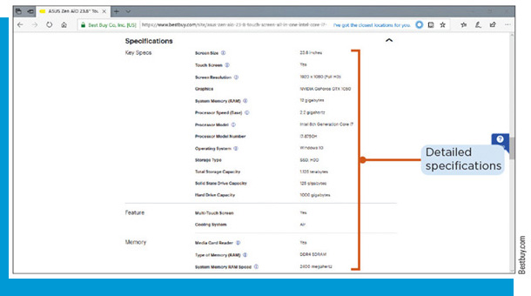
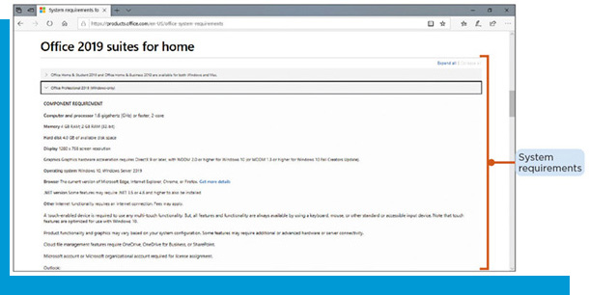
Hardware to Consider When Purchasing a Computer (3 of 3)

Slide 20
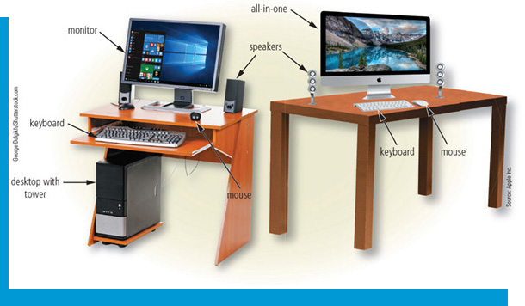
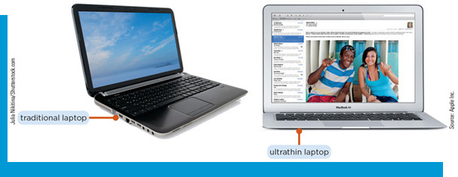
Demonstrate Familiarity with Input and Output Devices
Experiment with input devices
Experiment with output devices
Explain how to install computer hardware

Slide 21
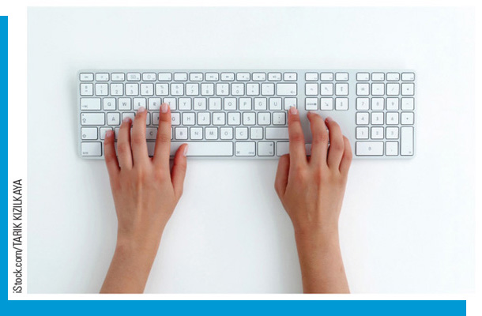

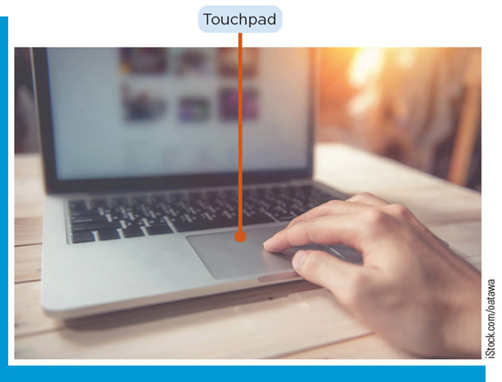
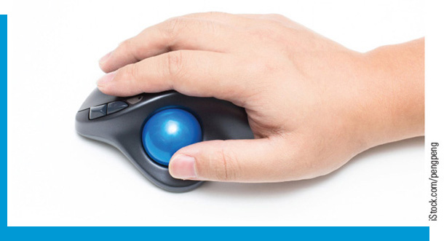
Experiment with Input Devices (1 of 2)
Input Devices
Keyboard
Pointing device
Mouse
Touchpad
Trackball
Touchscreen/multitouch screens

Slide 22
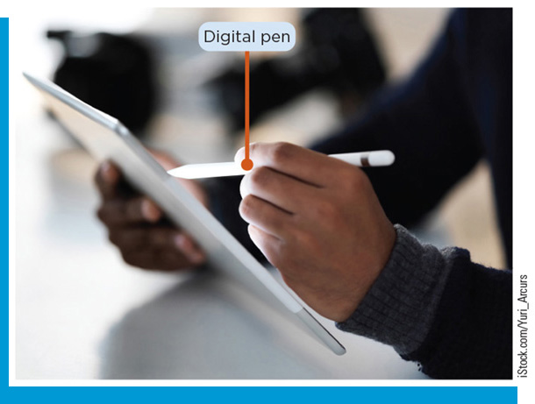
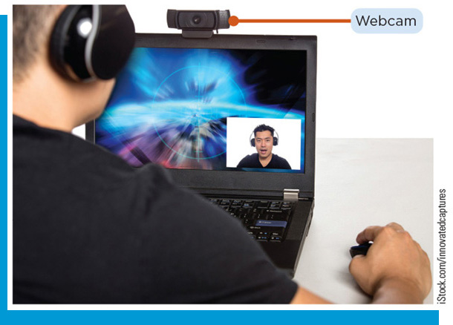
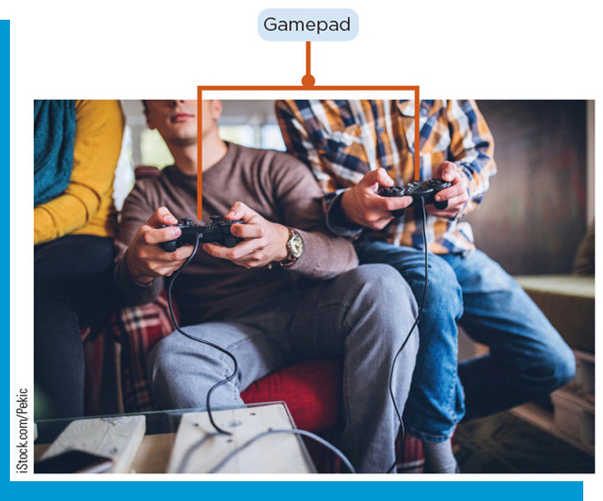
Experiment with Input Devices (2 of 2)
Pen Input
Stylus
Digital Pen
Microphone
Cameras/webcams
Scanner
Game controller
Joystick
Gamepad
Dance pad
Wheel
Motion-sensing controller

Slide 23
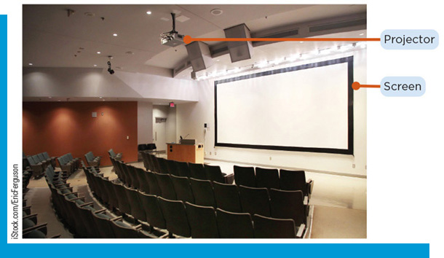
Experiment with Output Devices
Output Devices
Speakers
Headphones
Earbuds
Headsets
Projectors
Voice synthesizer
Printers
Ink-jet
Laser
Multifunction device (M F D)
Mobile
Plotter
3-D

Slide 24
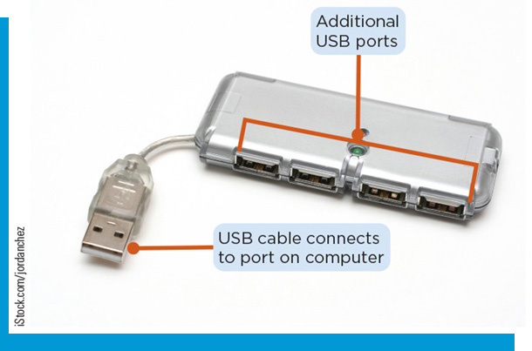
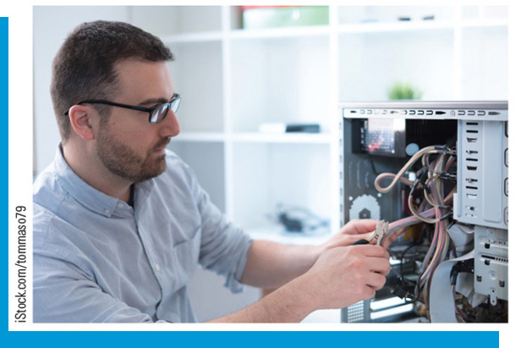
How to Install Computer Hardware
Installation
Ideal location
Check for all necessary components
Free from damage
Connect all components and accessories, then connect power
Turn on computer, follow on-screen steps
Peripherals
Plug-and-play
Device driver

Slide 25
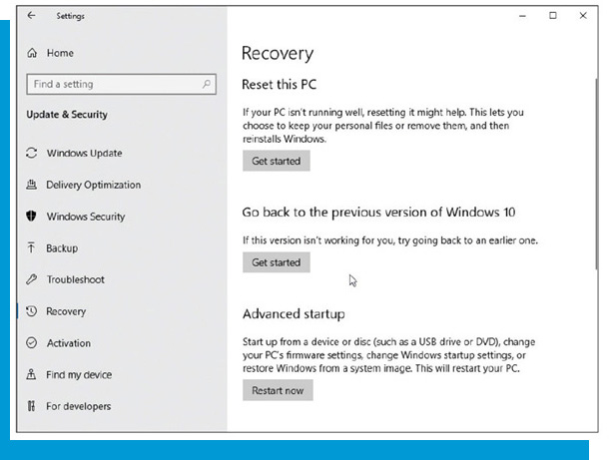
Maintain Hardware Components
Measure the performance of computer hardware
Explain how to troubleshoot problems with hardware and peripherals
Explain the necessary steps to maintain computer hardware
Explain how to restore a device and its associated hardware and software

Slide 26
Measure the Performance of Computer Hardware
Computer Performance
Processor clock speed
Bus width/word size
Benchmark

Slide 27
Troubleshooting Hardware Problems (1 of 4)
Common Hardware Problems
Device does not turn on
Battery issues
Computer issues a series of beeps when turned on
Operating system does not run
Monitor does not display
Keyboard/mouse does not work

Slide 28
Troubleshooting Hardware Problems (2 of 4)
Common Hardware Problems
Wet keyboard no longer works
Speakers do not work
Hard drive makes noise
Fan issues
Device is too hot
Cannot read from optical disc

Slide 29
Troubleshooting Hardware Problems (3 of 4)
Common Hardware Problems
External drive not recognized
Program/app does not run
Virus/malware
Slow performance
Screen damage
Touchscreen unresponsive

Slide 30
Troubleshooting Hardware Problems (4 of 4)
Common Hardware Problems
Liquid damage
Wireless network issues
Bluetooth issues
Mobile phone reception
Printer issues

Slide 31
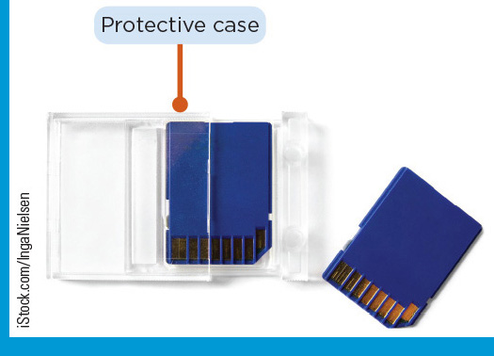
Steps to Maintain Computer Hardware (1 of 2)
Regular Maintenance
Clean display with damp cloth
Clean keyboard with compressed air
Keep air vent free of dust and debris
Media is clean, free of debris
Keep environment temperature controlled

Slide 32
Steps to Maintain Computer Hardware (2 of 2)
Regular Maintenance
Protect from power fluctuations
Uninterruptable power supply (U P S)
Surge suppressor
Keep free space on hard drive
Keep away from clutter/dust
Regularly back up data
Use protective cases for media

Slide 33
Restoring a Device (1 of 2)
Restoring the Operating System
Backup files
Follow system steps for restore

Slide 34
Restoring a Device (2 of 2)
Display issues
Ensure monitor is properly connected
Try monitor on different system to isolate
Try different power/video cables
Video card issues
Update drivers
Update feature of operating system
Download drivers from manufacturer website

